Slide 1

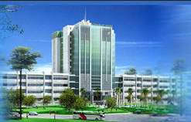
HCMC University of Technology and Education
Faculty of Electrical & Electronic Engineering
Lecture:
IMAGE PROCESSING
Chapter 4:
Image Filtering
1
Assoc. Prof. Nguyen Thanh Hai
Notes:
1

Slide 2
Image Filtering
INTRODUCTION
Image Filtering allows to apply various effects on images in order to filter noise or to smooth image.
The 2D filter is a 2D filter matrix
* Filtering in the spatial domain
Linear filtering is a weighted mask used to express the effects of the filter on each pixel of the image.
* Filtering in the frequency domain
Lots of noises: Gauss, impulse, etc.
Filters: lowpass, highpass, bandpass.

Slide 3
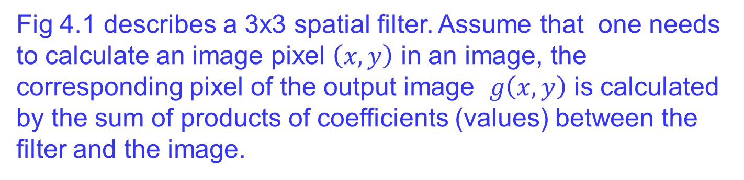
Image Filtering
IMAGE FILTERING IN THE SPATIAL DOMAIN
A spatial filter means that a typical pixel in image is calculated based on neighborhood pixels. The filter is moved to all image pixels to create the output image.
Fig 4.1 describes a 3x3 spatial filter. Assume that one needs to calculate an image pixel $\left(x,y\right)$ in an image, the corresponding pixel of the output image $g\left(x,y\right)$ is calculated by the sum of products of coefficients (values) between the filter and the image.

Slide 4
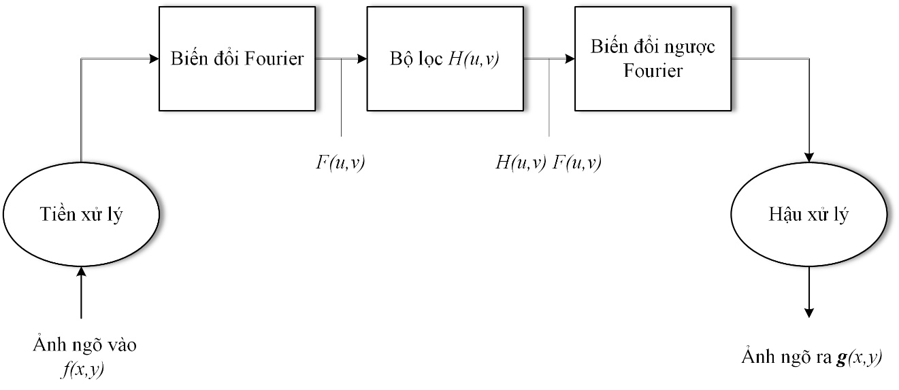
Image Filtering
IMAGE FILTERING IN THE FREQUENCY DOMAIN
- Some applications in frequency domain, one often uses the FT.
Image filtering in the frequency domain

Slide 5
Image Filtering
IMAGE FILTERING IN THE FREQUENCY DOMAIN

Slide 6
Image Filtering
IMAGE FILTERING IN THE FREQUENCY DOMAIN
According to diagram of Fig above, frequency filtering can be expressed in MATLAB using the following functions:
function g=dftfilt(f,H)
F=fft2(f,size(H,1),size(H,2));
G=H.*F;
g=ifft2(G);
f=real(g);
g=g(1:size(f,1),1:size(f,2))
end

Slide 7
Image Filtering
IMAGE FILTERING IN THE FREQUENCY DOMAIN
Ex 4.7: Express image filtering in the spatial domain using Sobel and in the frequency domain using DFT
clear all;
f=imread('cameraman.tif');
h=fspecial('sobel');
sizeH=size(f)*2;
H=freqz2(h,sizeH);
H1=ifftshift(H);
gd=dftfilt(f,H1);
gs=imfilter(double(f),h);
d=abs(gd-gs);
gd=uint8(gd);imshow(gd);
gd=uint8(gd);imshow(gs);

Slide 8
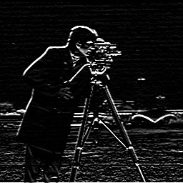



Image Filtering
IMAGE FILTERING IN THE FREQUENCY DOMAIN
Checking homologous between two methods:
$$d=\left|gs−gd\right|$$
In which gs is the image filtered in the spatial and gd is filtered in the frequency, results as in Fig. 4.6
Fig. 4.7. Sobel filter
(a). in the frequency
(b) in the spatial
(c) differential
$$\max_{}{d}=3.4106×{10}^{−13}$$

Slide 9
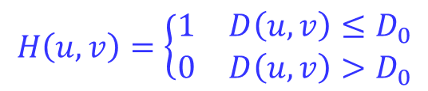
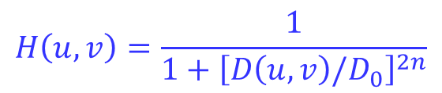
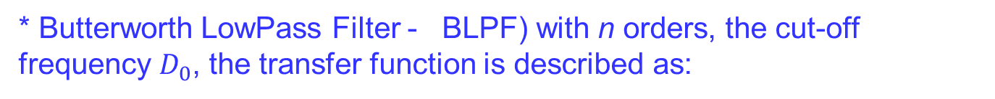
Image Filtering
Lowpass Filter: blurring image
* Ideal LowPass Filter - ILPF) : the transfer function is described as:
$$H\left(u,v\right)=\left\{\begin{matrix}1 & D\left(u,v\right)≤D_{0} \\ 0 & D\left(u,v\right)>D_{0}\end{matrix}\right.$$
where $D_{0}$ is the cut-off frequency with non-negative value, $D\left(u,v\right)$ is the distance from $\left(u,v\right)$ to the filter center. Orbit of $D\left(u,v\right)=D_{0}$ is a circle.
* Butterworth LowPass Filter - BLPF) with n orders, the cut-off frequency $D_{0}$, the transfer function is described as:
$$H\left(u,v\right)=\frac{1}{1+{\left[D\left(u,v\right)/D_{0}\right]}^{2n}}$$
Often define the cut-off frequency at positions of $H\left(u,v\right)=0.5$ (reduce 50% compared with the max value 1) when $D\left(u,v\right)=D_{0}$.
Calculate an example

Slide 10
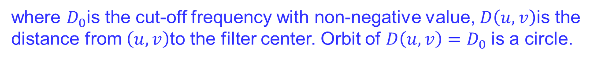
Image Filtering
Lowpass Filter: blurring image
* Ideal LowPass Filter - ILPF) : the transfer functions is described as:
$$H\left(u,v\right)=\left\{\begin{matrix}1 & D\left(u,v\right)≤D_{0} \\ 0 & D\left(u,v\right)>D_{0}\end{matrix}\right.$$
where $D_{0}$is the cut-off frequency with non-negative value, $D\left(u,v\right)$is the distance from $\left(u,v\right)$to the filter center. Orbit of $D\left(u,v\right)=D_{0}$is a circle.
For example:
The original image f and the Fourier coefficient image.

Slide 11
Image Filtering
Lowpass Filter: blurring image
The pixel positions of the original image.
Convert the center of image (u-H/2, v-W/2), in this case H=W=4, (u-2, v-2).
The centered image.
The centered Fourier image.

Slide 12
Image Filtering
Lowpass Filter: blurring image
Sqrt(u²+v²)<=D₀; Assume that D₀=H/2=4/2=2
The filtered image.

Slide 13
Image Filtering
Lowpass Filter: blurring image
The image after filtering
g =
0.25 + 0.1250i -0.125 - 0.25i 0.1250i -0.125
-0.125 - 0.25i 0.75 + 0.375i -0.625 -0.1250i
0.125i -0.625 0.75 - 0.375i -0.125 + 0.25i
-0.125 -0.1250i -0.125 + 0.25i 0.25 - 0.125i
g_real =
0.25 -0.125 0 -0.125
-0.125 0.75 -0.625 0
0 -0.625 0.75 -0.125
-0.125 0 -0.125 0.25
g_non-negative integer =
0 0 0 0
0 1 0 0
0 0 1 0
0 0 0 0
>=0.5 ; 1 and <0.5; 0

Slide 14
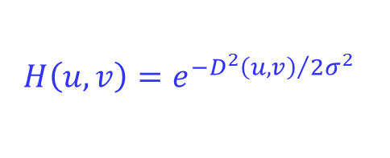
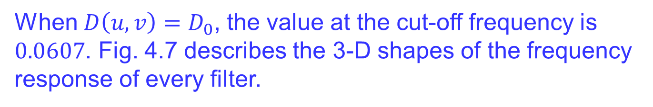
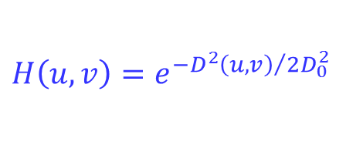
Image Filtering
IMAGE FILTERING IN THE FREQUENCY DOMAIN
Transfer function of the Gaussian Lowpass Filter (GLPF) is expressed as follows:
$$H\left(u,v\right)=e^{{−D^{2}\left(u,v\right)}/{2σ^{2}}}$$
In which $σ$ is the standard deviation. If $σ=D_{0}$, we have :
$$H\left(u,v\right)=e^{{−D^{2}\left(u,v\right)}/{2D_{0}^{2}}}$$
When $D\left(u,v\right)=D_{0}$, the value at the cut-off frequency is $0.0607$. Fig. 4.7 describes the 3-D shapes of the frequency response of every filter.

Slide 15
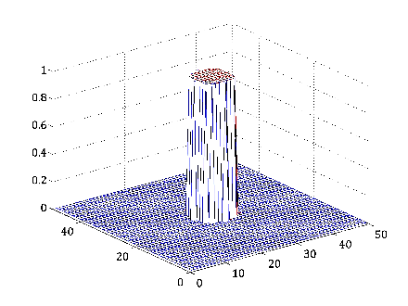
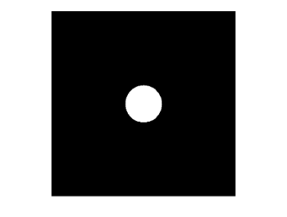
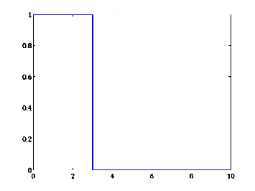
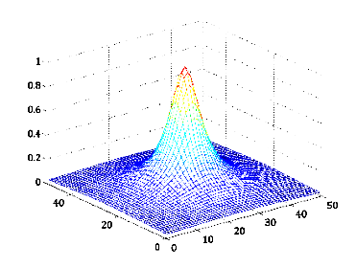
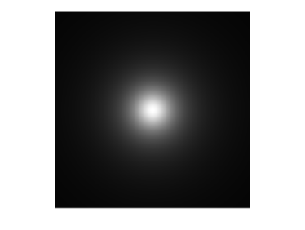
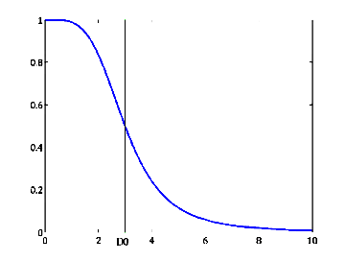
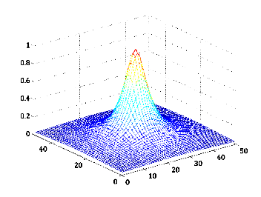
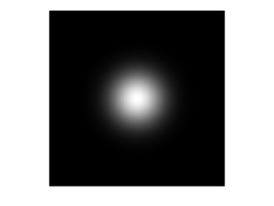
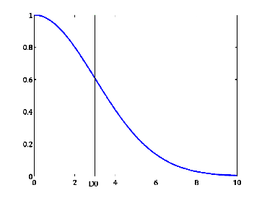
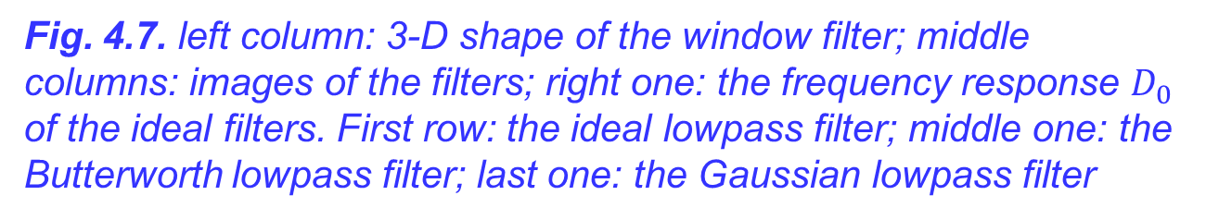
Image Filtering
Fig. 4.7. left column: 3-D shape of the window filter; middle columns: images of the filters; right one: the frequency response $D_{0}$ of the ideal filters. First row: the ideal lowpass filter; middle one: the Butterworth lowpass filter; last one: the Gaussian lowpass filter

Slide 16
Image Filtering
EX: Build a lowpass filter function as lpfilter with 3 basic filters.
function [H,D]=lpfilter(type,M,N,DO,n)
[U,V]=dftuv(M,N);
D=sqrt(U.^2+V.^2);
switch type
case 'ideal'
H=double(D<=DO);
case 'btw'
if nargin==4
n=1;
end
H=1./(1+(D./DO).^(2*n));
case 'gaussian'
H=exp(-(D.^2)./(2*(DO^2)));
otherwise
error('Unknown filter type');
end
Some functions in toolbox:
- mesh(H): express information in 3D such as x=1:M và y=1:N, with [M,N]=size(H).
- mesh(H(1:k:end,1:k:end))
- colormap([0 0 0]): black-white

Slide 17
Image Filtering
IMAGE FILTERING IN THE FREQUENCY DOMAIN
Ex 4.3: express the plot using mesh for the Butterworth lowpass filter with different orders.
clear all;
BLPF1=fftshift(lpfilter('btw',500,500,50,1));
mesh(BLPF1(1:10:500,1:10:500));
axis([0 50 0 50 0 1]);
saveas(gcf, 'Hinh3.7a.tif', 'tif');
BLPF2=fftshift(lpfilter('btw',500,500,50,2));
figure;mesh(BLPF2(1:10:500,1:10:500));
axis([0 50 0 50 0 1]);
saveas(gcf, 'Hinh3.7b.tif', 'tif');
BLPF3=fftshift(lpfilter('btw',500,500,50,3));
figure;mesh(BLPF3(1:10:500,1:10:500));
axis([0 50 0 50 0 1]);
saveas(gcf, 'Hinh3.7c.tif', 'tif');
BLPF4=fftshift(lpfilter('btw',500,500,50,4));
figure;mesh(BLPF4(1:10:500,1:10:500));
axis([0 50 0 50 0 1]);
saveas(gcf, 'Hinh3.7d.tif', 'tif');

Slide 18
Image Filtering
IMAGE FILTERING IN THE FREQUENCY DOMAIN
BLPF3=fftshift(lpfilter('btw',500,500,50,3));
figure;mesh(BLPF3(1:10:500,1:10:500));
axis([0 50 0 50 0 1]);
saveas(gcf, 'Hinh3.7c.tif', 'tif');
BLPF4=fftshift(lpfilter('btw',500,500,50,4));
figure;mesh(BLPF4(1:10:500,1:10:500));
axis([0 50 0 50 0 1]);
saveas(gcf, 'Hinh3.7d.tif', 'tif');

Slide 19
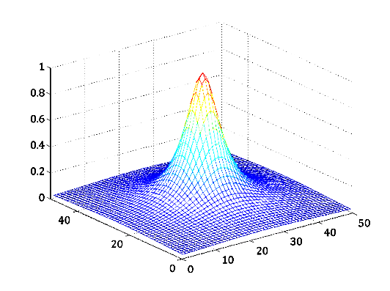
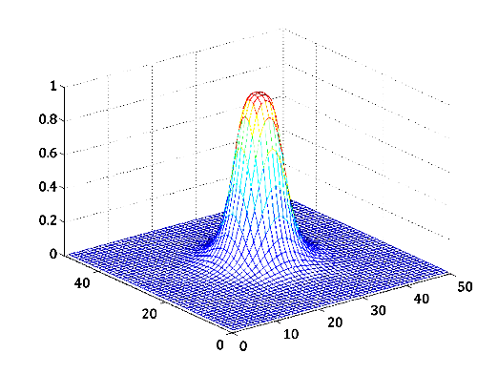
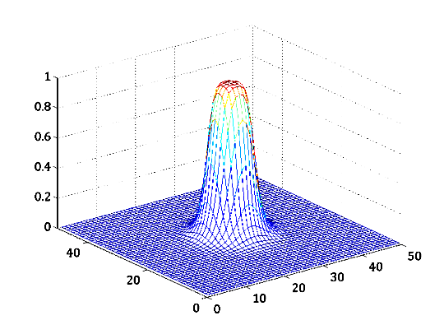
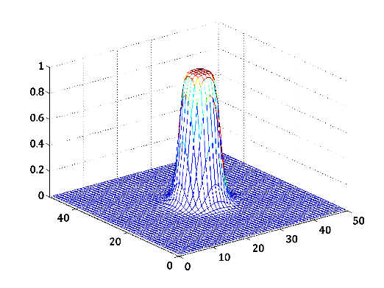
Image Filtering
IMAGE FILTERING IN THE FREQUENCY DOMAIN
(a) Order 1
(b) Order 2
(c) Order 3
(d) Order 4
Fig 4.8. Plots of the Butterworth lowpass filters with different orders.

Slide 20
Image Filtering
IMAGE FILTERING IN THE FREQUENCY DOMAIN
Ex 4.4: express the lowpass filter with different cut-off frequencies and compare results
D03=3/5*size(f,1);
[M,N]=size(f);
[H,D]=lpfilter('ideal',2*M,2*N,D03);
g=dftfilt(f,H);
D04=4/5*size(f,1);
[M,N]=size(f);
[H,D]=lpfilter('ideal',2*M,2*N,D04);
g=dftfilt(f,H);
D05=size(f,1);
[M,N]=size(f);
[H,D]=lpfilter('ideal',2*M,2*N,D04);
g=dftfilt(f,H);
clear all;
f=imread('cameraman.bmp');
D01=1/5*size(f,1);
[M,N]=size(f);
[H,D]=lpfilter('ideal',2*M,2*N,D01);
g=dftfilt(f,H);
D02=2/5*size(f,1);
[M,N]=size(f);
[H,D]=lpfilter('ideal',2*M,2*N,D02);
g=dftfilt(f,H);

Slide 21
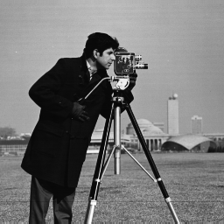
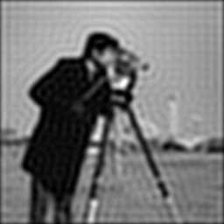
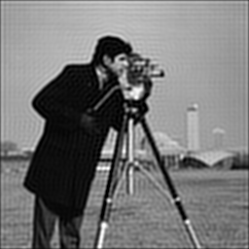

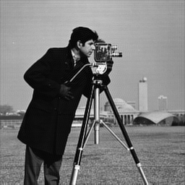





Image Filtering
(a) Original image
(b) $D_{0}=\frac{M}{5}$
(c) $D_{0}=\frac{2M}{5}$
(d) $D_{0}=\frac{3M}{5}$
(e) $D_{0}=\frac{4M}{5}$
(f) $D_{0}=M$
Fig 4.9. cameraman $M×N$ image after the ideal lowpass filter with different cut-off frequencies

Slide 22
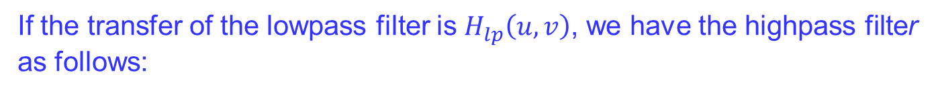

Image Filtering
Ideal highpass filter
The ideal highpass filter is often implemented to filter image sharper by eliminating the low frequencies
If the transfer of the lowpass filter is $H_{lp}\left(u,v\right)$, we have the highpass filter as follows:
$$H_{hp}\left(u,v\right)=1−H_{lp}\left(u,v\right)$$
Build the highpass filter function using Matlab
function H=hpfilter(type,M,N,D0,n)
if nargin==4
n=1;
End
Hlp=lpfilter(type,M,N,D0,n);
H=1-Hlp;
end

Slide 23
Image Filtering
IMAGE FILTERING IN THE FREQUENCY DOMAIN
Ex 4.5: Express the highpass filter using the function mesh for image.
clear all;close all;clc
ILPF=fftshift(hpfilter('ideal',500,500,50));
mesh(ILPF(1:10:500,1:10:500));
axis([0 50 0 50 0 1]);
BLPF=fftshift(hpfilter('btw',500,500,50));
mesh(BLPF(1:10:500,1:10:500));
axis([0 50 0 50 0 1]);
GLPF=fftshift(hpfilter('gaussian',500,500,50));
mesh(GLPF(1:10:500,1:10:500));
axis([0 50 0 50 0 1]);

Slide 24
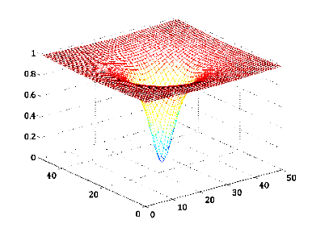
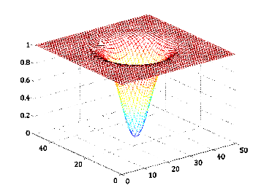
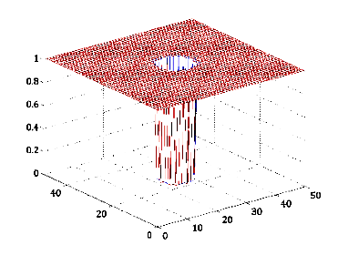

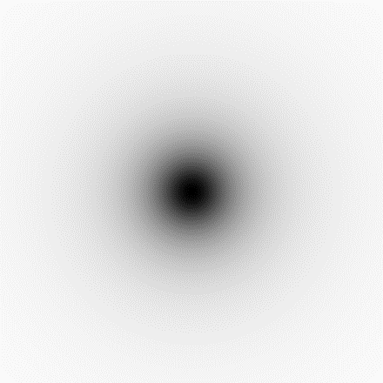
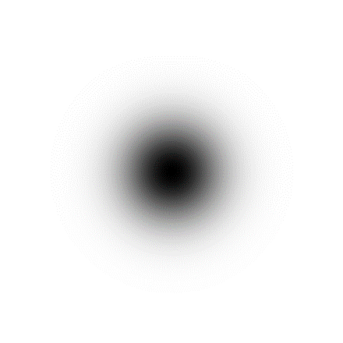
Image Filtering
IMAGE FILTERING IN THE FREQUENCY DOMAIN
(b)
(c)
(a)
(d)
(e)
(f)
Fig. 4.10. Express the highpass filter. Top row: mesh with the 3-D shape; bottom row: 2D images of the mesh; left column: the ideal highpass filter, middle columns: the Butterworth highpass filter, right one: the Gaussian highpass filter

Slide 25

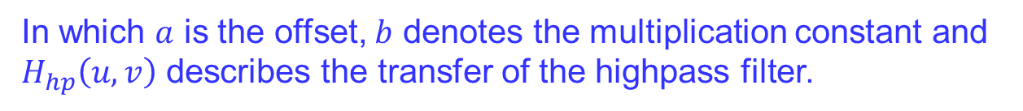
Image Filtering
IMAGE FILTERING IN THE FREQUENCY DOMAIN
The highpass filter is normalized to be zero to the DC components. Thus, this will reduce the average value of the image onto zero.
For improvement, the DC offset components are added to the highpass filter.
The high frequency emphasis filtering with offset is expressed as follows:
$$H_{hfe}\left(u,v\right)=a+bH_{hp}\left(u,v\right)$$
In which $a$ is the offset, $b$ denotes the multiplication constant and $H_{hp}\left(u,v\right)$ describes the transfer of the highpass filter.

Slide 26
Image Filtering
IMAGE FILTERING IN THE FREQUENCY DOMAIN
Ex 4.6: express the high frequency emphasis filtering using Matlab.
clear all;
f=imread('satellite.tiff');
[M N]=size(f);
D0=0.1*size(f,1);
HBW=hpfilter('btw',2*M,2*N,D0);
H=0.5+2*HBW;
gbw=dftfilt(f,HBW);
gbw=gscale(gbw);
ghf=dftfilt(f,H);
ghf=gscale(ghf);
ghe=histeq(ghf,256);

Slide 27
Image Filtering
IMAGE FILTERING IN THE FREQUENCY DOMAIN
In the Ex 4.6, the gscale allows to normalize and change data type containing the gray intensity in image. The gscale function is proposed:
function g=gscale(f)
fmin=min(f(:));
fmax=max(f(:));
for i=1:size(f,1)
for j=1:size(f,2)
g(i,j)=255*(f(i,j)-fmin)/(fmax-fmin);
end
end
g=uint8(g);
end

Slide 28
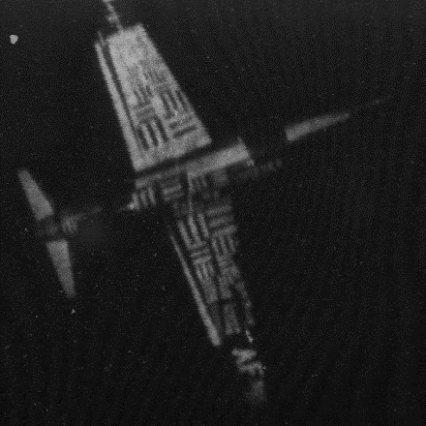
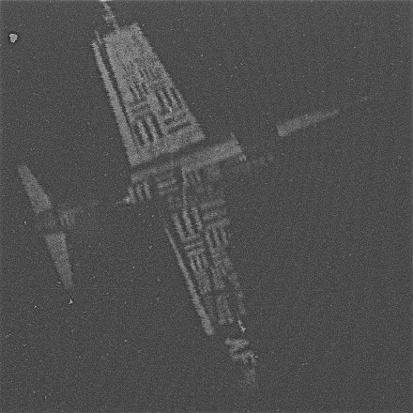
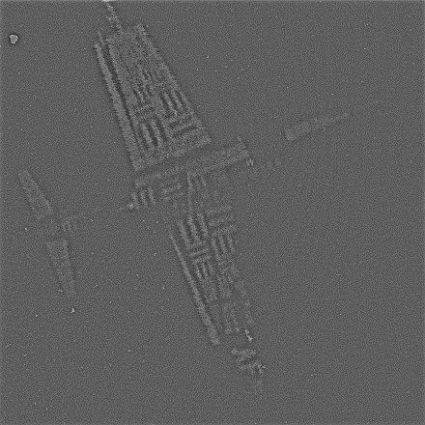
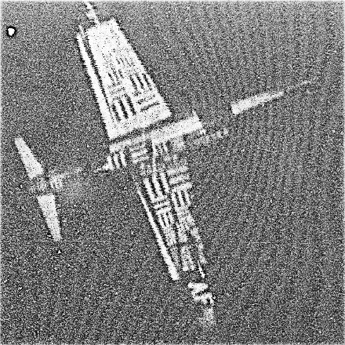
Image Filtering
(a) Blurring satellite image
(c) Image after the emphasis highpass filter
(b) Image after the Butterworth highpass filter
(d) Image after the histogram equalization of image (c)
Ex 4.11. Satellite image after the highpass filter

Slide 29
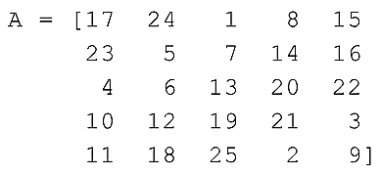
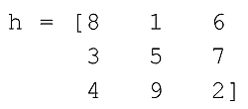
HCMC University of Technology and Education
Faculty of Electrical & Electronics Engineering
Image Filtering
Problem: Calculate the convolution of the image A and the mask h.
Suppose the input image is
And the kernel (mask)
29
Assoc. Prof. Nguyen Thanh Hai
Notes:
29

Slide 30
HCMC University of Technology and Education
Faculty of Electrical & Electronics Engineering
Image Filtering
The End
30
Assoc. Prof. Nguyen Thanh Hai
Notes:
30

